Slide 1
Chapter 7
Arrays
Dai Liyun
dailiyun@swu.edu.cn

Slide 2
Chapter 7
7.1 INTRODUCTION TO ARRAYS
7.2 ARRAYS IN FUNCTIONS
7.3 PROGRAMMING WITH ARRAYS
7.4 MULTIDIMENSIONAL ARRAYS

Slide 3

7.1 INTRODUCTION TO ARRAYS Declaring and Referencing Arrays
int score[5];
score[0], score[1], score[2], score[3], score[4]ss
int next, score[5], max;
int n = 2;
score[n + 1] = 99;
Usage:
Usage:

Slide 4
Use for Loops with Arrays
for (i = 0; i < 5; i++)
cout << score[i] << " off by "
<< (max - score[i]) << endl;
（1）Array Indexes Always Start with Zero
（2）Array Index Out of Range
Note：

Slide 5
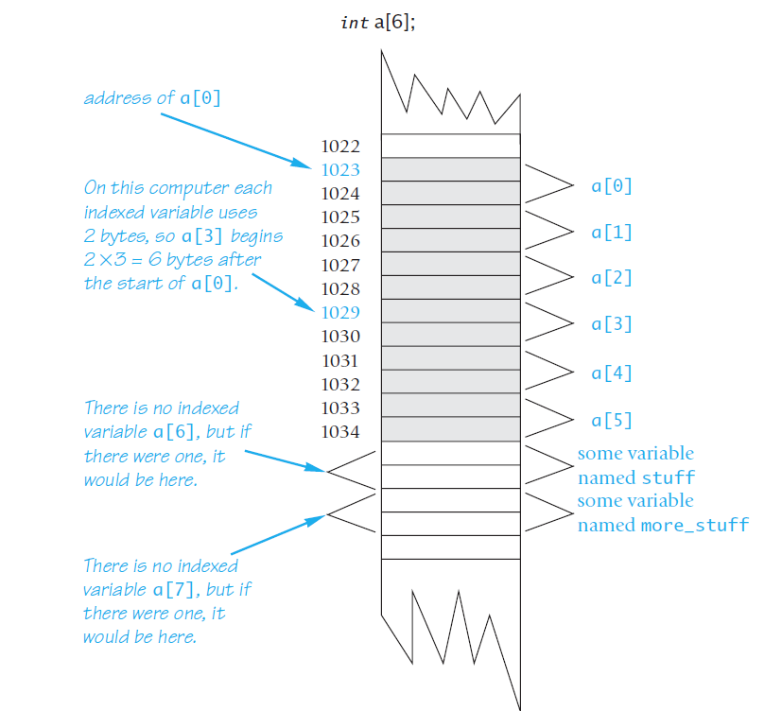
An Array in Memory

Slide 6
Initializing Arrays
For example,
int children[3] = {2, 12, 1};
This declaration is equivalent to the following code:
int children[3];
children[0] = 2;
children[1] = 12;
children[2] = 1;

Slide 7
Initializing Arrays
For example, the following declaration
int b[] = {5, 12, 11};
is equivalent to
int b[3] = {5, 12, 11};

Slide 8
ARRAYS IN FUNCTIONS

Slide 9
Review
3. Identify any errors in the following array declarations.
a. int x[4] = { 8, 7, 6, 4, 3 };
b. int x[] = { 8, 7, 6, 4 };
c. const int SIZE = 4; int x[SIZE];

Slide 10
7. What is wrong with the following piece of code?
int sample_array[10];
for (int index = 1; index <= 10; index++)
sample_array[index] = 3*index;

Slide 11
Indexed Variables as Function Arguments
int i, n, a[10];
my_function takes one argument of type int,
my_function(n);
Since an indexed variable of the array a is also a variable of type int, just like n, the following is equally legal:
my_function(a[3]);
There is one subtlety that does apply to indexed variables used as
arguments. For example, consider the following function call:
my_function(a[i]);

Slide 12
Entire Arrays as Function Arguments
//Uses iostream:
void fill_up(int a[], int size)
{
using namespace std;
cout << "Enter " << size << " numbers:\n";
for (int i = 0; i < size; i++)
cin >> a[i];
size--;
cout << "The last array index used is " << size << endl;
}

Slide 13
The const Parameter Modifier
void show_the_world(const int a[], int size_of_a)
//Precondition: size_of_a is the declared size of the array a.
//All indexed variables of a have been given values.
//Postcondition: The values in a have been written
//to the screen.
{
cout << "The array contains the following values:\n";
for (int i = 0; i < size_of_a; a[i]++)
cout << a[i] << " ";
cout << endl;
}

Slide 14
Test
void too2(int a[], int how_many)
{
for (int index = 0; index < how_many; index++)
a[index] = 2;
}
Which of the following are acceptable function calls?
int my_array[29];
A: too2(my_array, 29);
B: too2(my_array, 10);
C: too2(my_array, 55);

Slide 15
PROGRAMMING WITH ARRAYS
fill_array(score, MAX_NUMBER_SCORES, number_used);
double compute_average(const int a[], int number_used)
void show_difference(const int a[], int number_used)
Search int search(const int a[], int number_used, int target)

Slide 16
Sorting an Array
void sort(int a[], int number_used);
//Precondition: number_used <= declared size of the array a.
//Array elements a[0] through a[number_used-1] have values.
The function sort rearranges the elements in array a so that after the function call is completed the elements are sorted as follows:
a[0] ≤ a[1] ≤ a[2] ≤ ... ≤ a[number_used - 1]

Slide 17
selection sort algorithm
for (int index = 0; index < number_used; index++)
Place the indexth smallest element in a[index]

Slide 18
7.2 CALL-BY-REFERENCE PARAMETERS
void get_input(double& f_variable)
{
cout << "I will convert a Fahrenheit temperature"
<< " to Celsius.\n"
<< "Enter a temperature in Fahrenheit: ";
cin >> f_variable;
}
double a=1.0;
get_input(a);
cout<< a;
Input: 20.22

Slide 19
7.2 CALL-BY-REFERENCE PARAMETERS
void get_input(double& f_variable)
{
cout << "I will convert a Fahrenheit temperature"
<< " to Celsius.\n"
<< "Enter a temperature in Fahrenheit: ";
cin >> f_variable;
}
double a=1.0;
get_input(a);
cout<< a;
output: 20.22

Slide 20
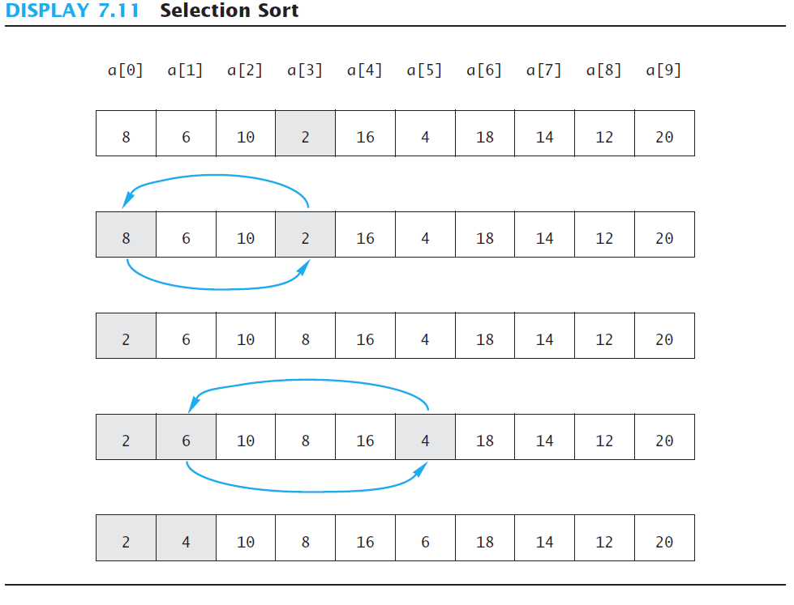
selection sort algorithm

Slide 21
selection sort algorithm
for (int index = 0; index < number_used; index++)
find the smallest element a in [index, number_used)
swap_values(a, a[index])
int index_of_smallest(const int a[], int start_index, int number_used);
void swap_values(int& v1, int& v2);

Slide 22
MULTIDIMENSIONAL ARRAYS

Slide 23
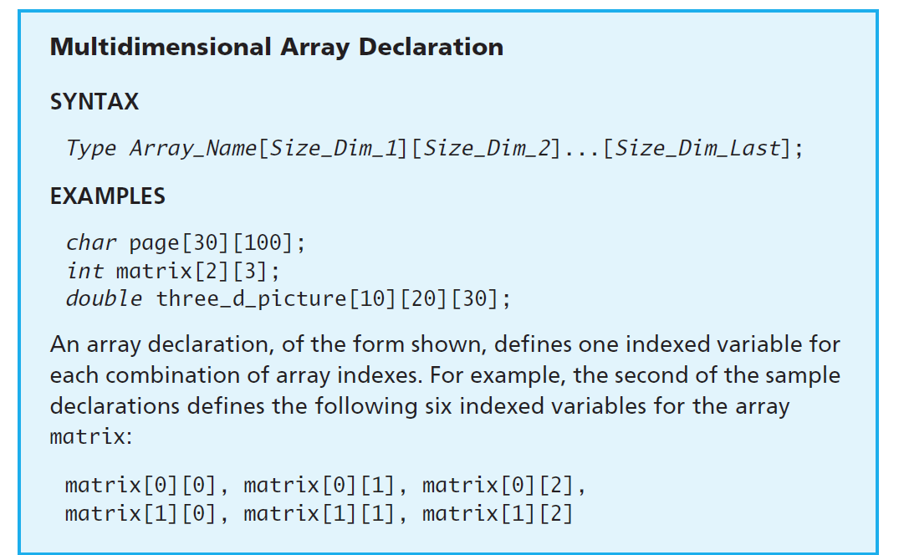
Multidimensional Array Declaration

Slide 24
Test
Page 440 exercise 11

Slide 25
Project 2
Computing the number of occurrences of the highest number of 10 roles in novel “射雕英雄传”. And ploting the result in SVG file.

